Slide 1


Mechanics of Machines Dynamic Force Analysis Module 5: Flywheel, Turning moment diagram
Tapan Kumar Mahanta, Ph.D.
SMEC Chennai Campus

Slide 2
Dynamic Force Analysis:
Class Objective1: Where we use Flywheel ?
Class objective2: Turning moment diagram

Slide 3
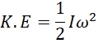
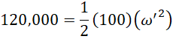
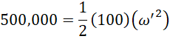







Where we use flywheel:
Fluctuation of energy.
100,000J
ω=20 rad/s
100,000J
ω=20 rad/s
I=1900 kg.m^2
I=100 kg.m^2
I=100 kg.m^2
Rotational =20,000J
Rotational =400,000J
Total Energy=100,000J+20,000J=120,000 J
So
Change in angular speed= 29 rad/s
Total Energy=100,000J+400,000J=500,000 J
So
Change in angular speed= 2 rad/s
Fluctuation of speed reduced when we attached a disc (Flywheel) over the rotating shaft

Slide 4
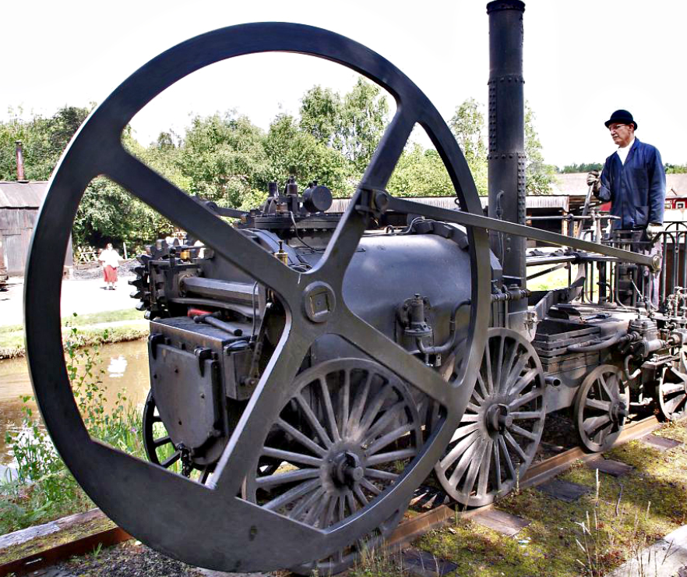
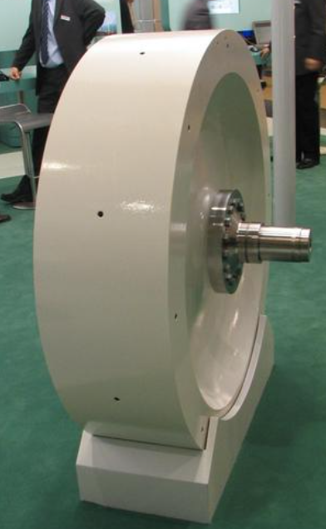
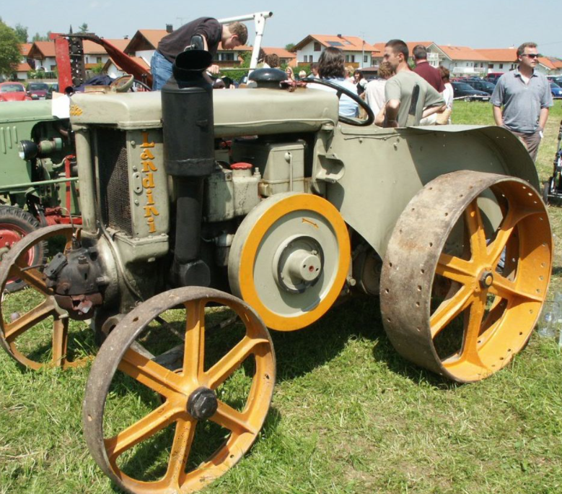
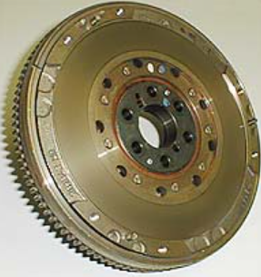
Flywheel :
Flywheel is a device used to control fluctuation of speed by acting as energy reservoir.
A flywheel is used to control the variations in speed during each cycle of an engine.
During the periods when the supply of energy is more than required, it stores energy and during the requirements is more than the supply, it releases energy.
Steam locomotive flywheel
An industrial flywheel
Tractor with exposed flywheel
Automobile engine flywheel

Slide 5
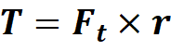
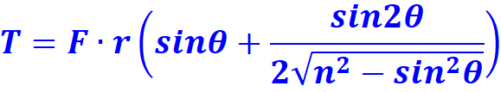
Turning moment Diagram :
Turning moment on crank shaft (T)
Where F is the net piston effort
Plot of T vs θ is known as the turning-moment diagram.
Plot of Ft vs θ is known as crank effort diagram

Slide 6
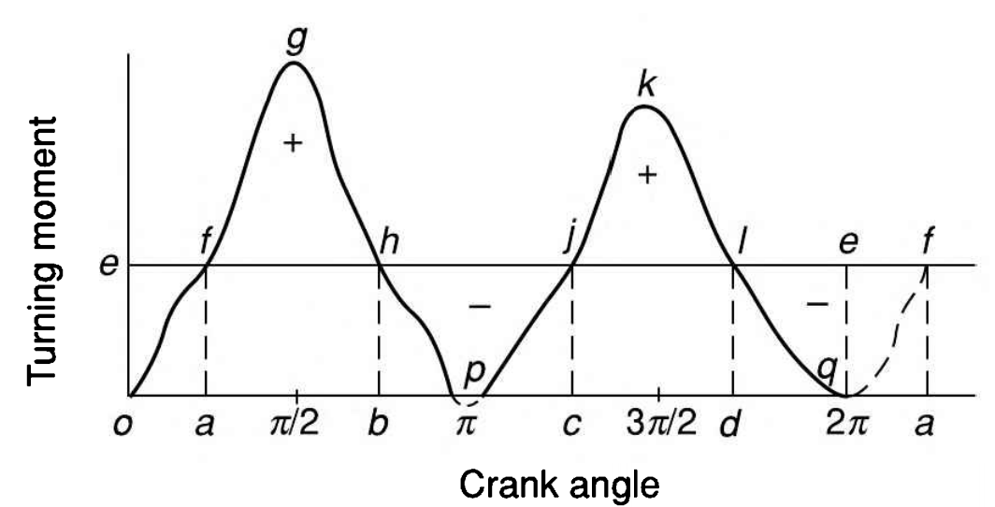
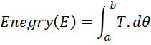
Single-cylinder Double acting Steam Engine:
In one cycle:
Total store energy=total release energy

Slide 7
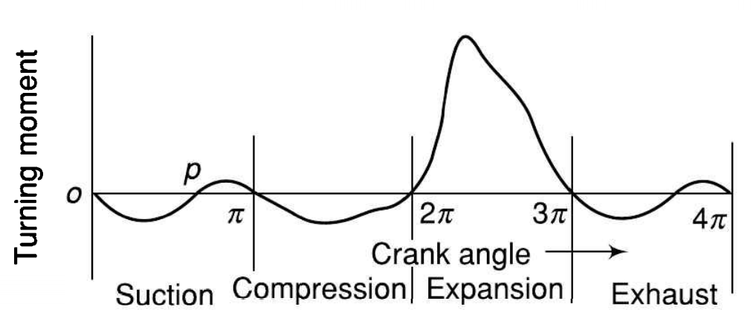
Single-cylinder Four-stroke Engine:

Slide 8
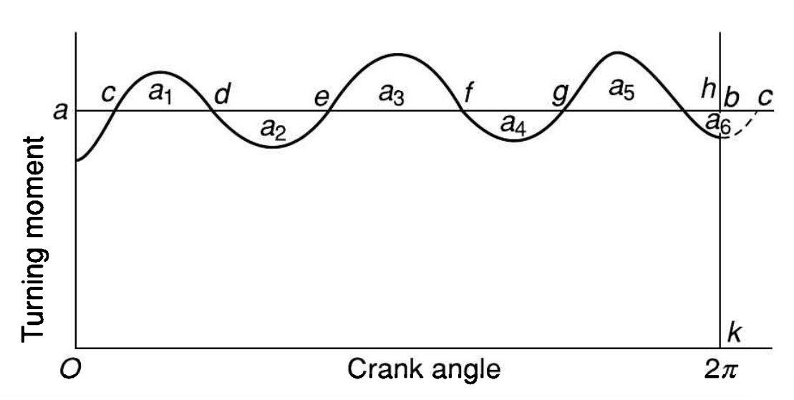
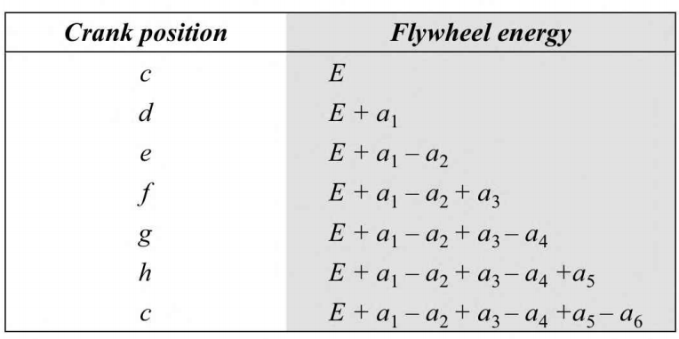
Multi cylinder Engines:

Slide 9
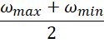
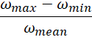
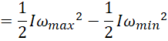
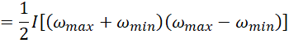
Flywheel fluctuation of speed and fluctuation of energy:
I = moment of inertia of the flywheel
ωmax = maximum speed
ωmin = minimum speed
ωmean= mean speed=
Fluctuation of speed= Range of speed=
Coefficient of fluctuation of speed ( )= ** Coefficient of steadiness =
Maximum fluctuation of energy ( )=

Slide 10
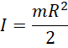
Flywheel shape and their moment of inertia :
Whenever there is difference between Tavailable and Tresisting or Tmean flywheel is needed.
For solid disc For annular disc
R
R
m
m

Slide 11
Problem1 :
A flywheel with a mass of 3kN ahs a radius of gyration of 1.6m. Find the energy stored in the flywheel when its speed increase from 315 rpm to 340 rpm.

Slide 12
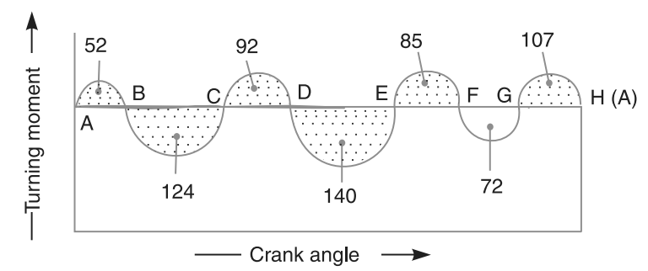
Problem2 :
The turning moment diagram for a multi-cylinder engine has been drawn to a scale 1 mm = 600 N-m vertically and 1 mm = 30° horizontally. The intercepted areas between the output torque curve and the mean resistance line, taken in order from one end, are as follows : + 52, – 124, + 92, – 140, + 85, – 72 and + 107 mm2 , when the engine is running at a speed of 600 r.p.m. If the total fluctuation of speed is not to exceed ± 1.5% of the mean, find the necessary mass of the flywheel of radius 0.5 m.

Slide 13
Problem3 :
The turning moment diagram of a four stroke engine is assumed to be represented by four triangles, the areas of which from the line of zero pressure are
suction stroke=440
compression stroke= 1600
expansion stroke= 7200
exhaust stroke= 660
Each of area represents 3Nm of energy. It the resisting torque is uniform,
determine the mass of the rim of flywheel to keep the speed between 218 and 222 rpm when the mean radius of the rim is to be 1.25.

Slide 14


Slide 15
Problem4 :
Turning moment equation of an engine T= 20000+9500 sin2θ-5700cos2θ
where θ is angle turned by crank from IDC. Assuming resisting torque to be constant and maximum fluctuations are 1% with respect to mean speed 300 rpm. Find
a) Power developed by engine
b) Mass of flywheel if its radius of gyration is 1.5m
c) Angular acceleration of flywheel at the position when the crank has rotated by 45°from IDC.

